Slide 1


Clumsy Guppy Studios present:
Isabelle Cordova + Diana Kumykova

Slide 2

Logline
Raise your own little pathogen!
Let’s go
Notes:
Coronagotchi allows players to live out the nostalgia of older handheld games while either helping or harming their little Corona pet in this dark humor twist on the classic Tamagotchi.

Slide 3
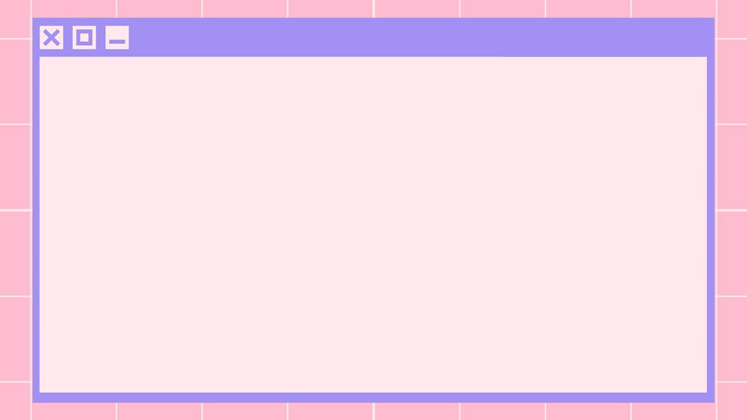
Game Description
Coronagotchi allows players to live out the nostalgia of older handheld games while either helping or harming their little coronavirus pet in this dark humor twist on the classic Tamagotchi device.

Slide 4
Essential Features
Feed, play with, and care for your virus
Dress your virus in fun costumes
Watch your virus grow from a speck to a fully grown havoc machine!
Or, if you so choose, let it die

Slide 5
How Coronagotchi Will Work
Each player starts the game with a baby virus that they can feed, nurture,and play with until they have their own cute fully grown pathogen! Players are able to play fun mouse-controlled mini-games such as:
Moving their Corona around to catch food while avoiding vaccines that hurt their hunger
Dress their Corona in the latest viral fashion trends
Memorize nucleotides to mutate
Break down biological defenses
The goal of Coronagotchi is to raise your corona to be big and strong - then see what happens!

Slide 6
Artist Statement
Our creation is meant to provide comedic relief from the COVID-19 pandemic by putting a dark spin on a classic game. We hope we provided an escape from the madness through nostalgia and a heavy dose of irony.

Slide 7
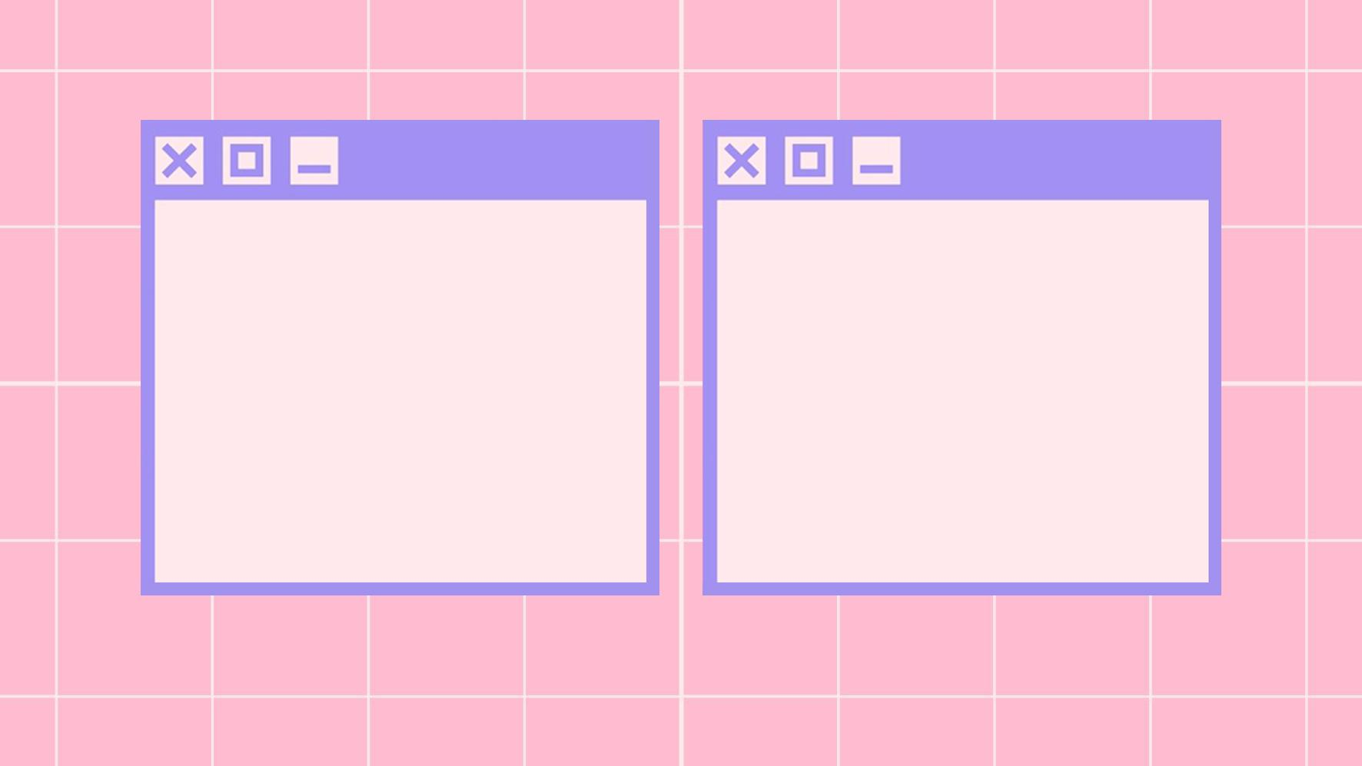
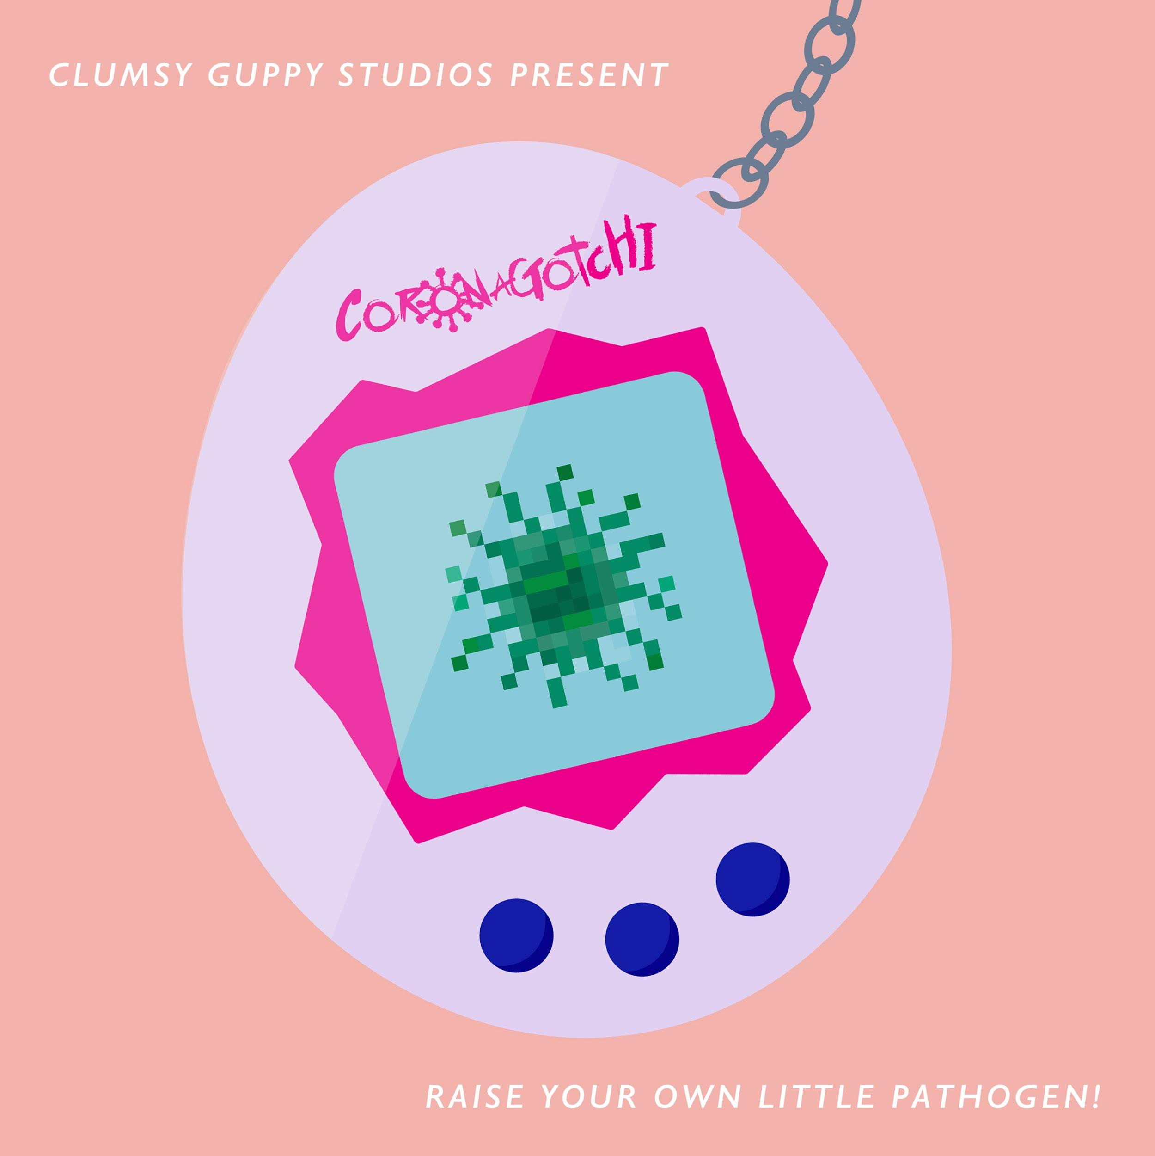
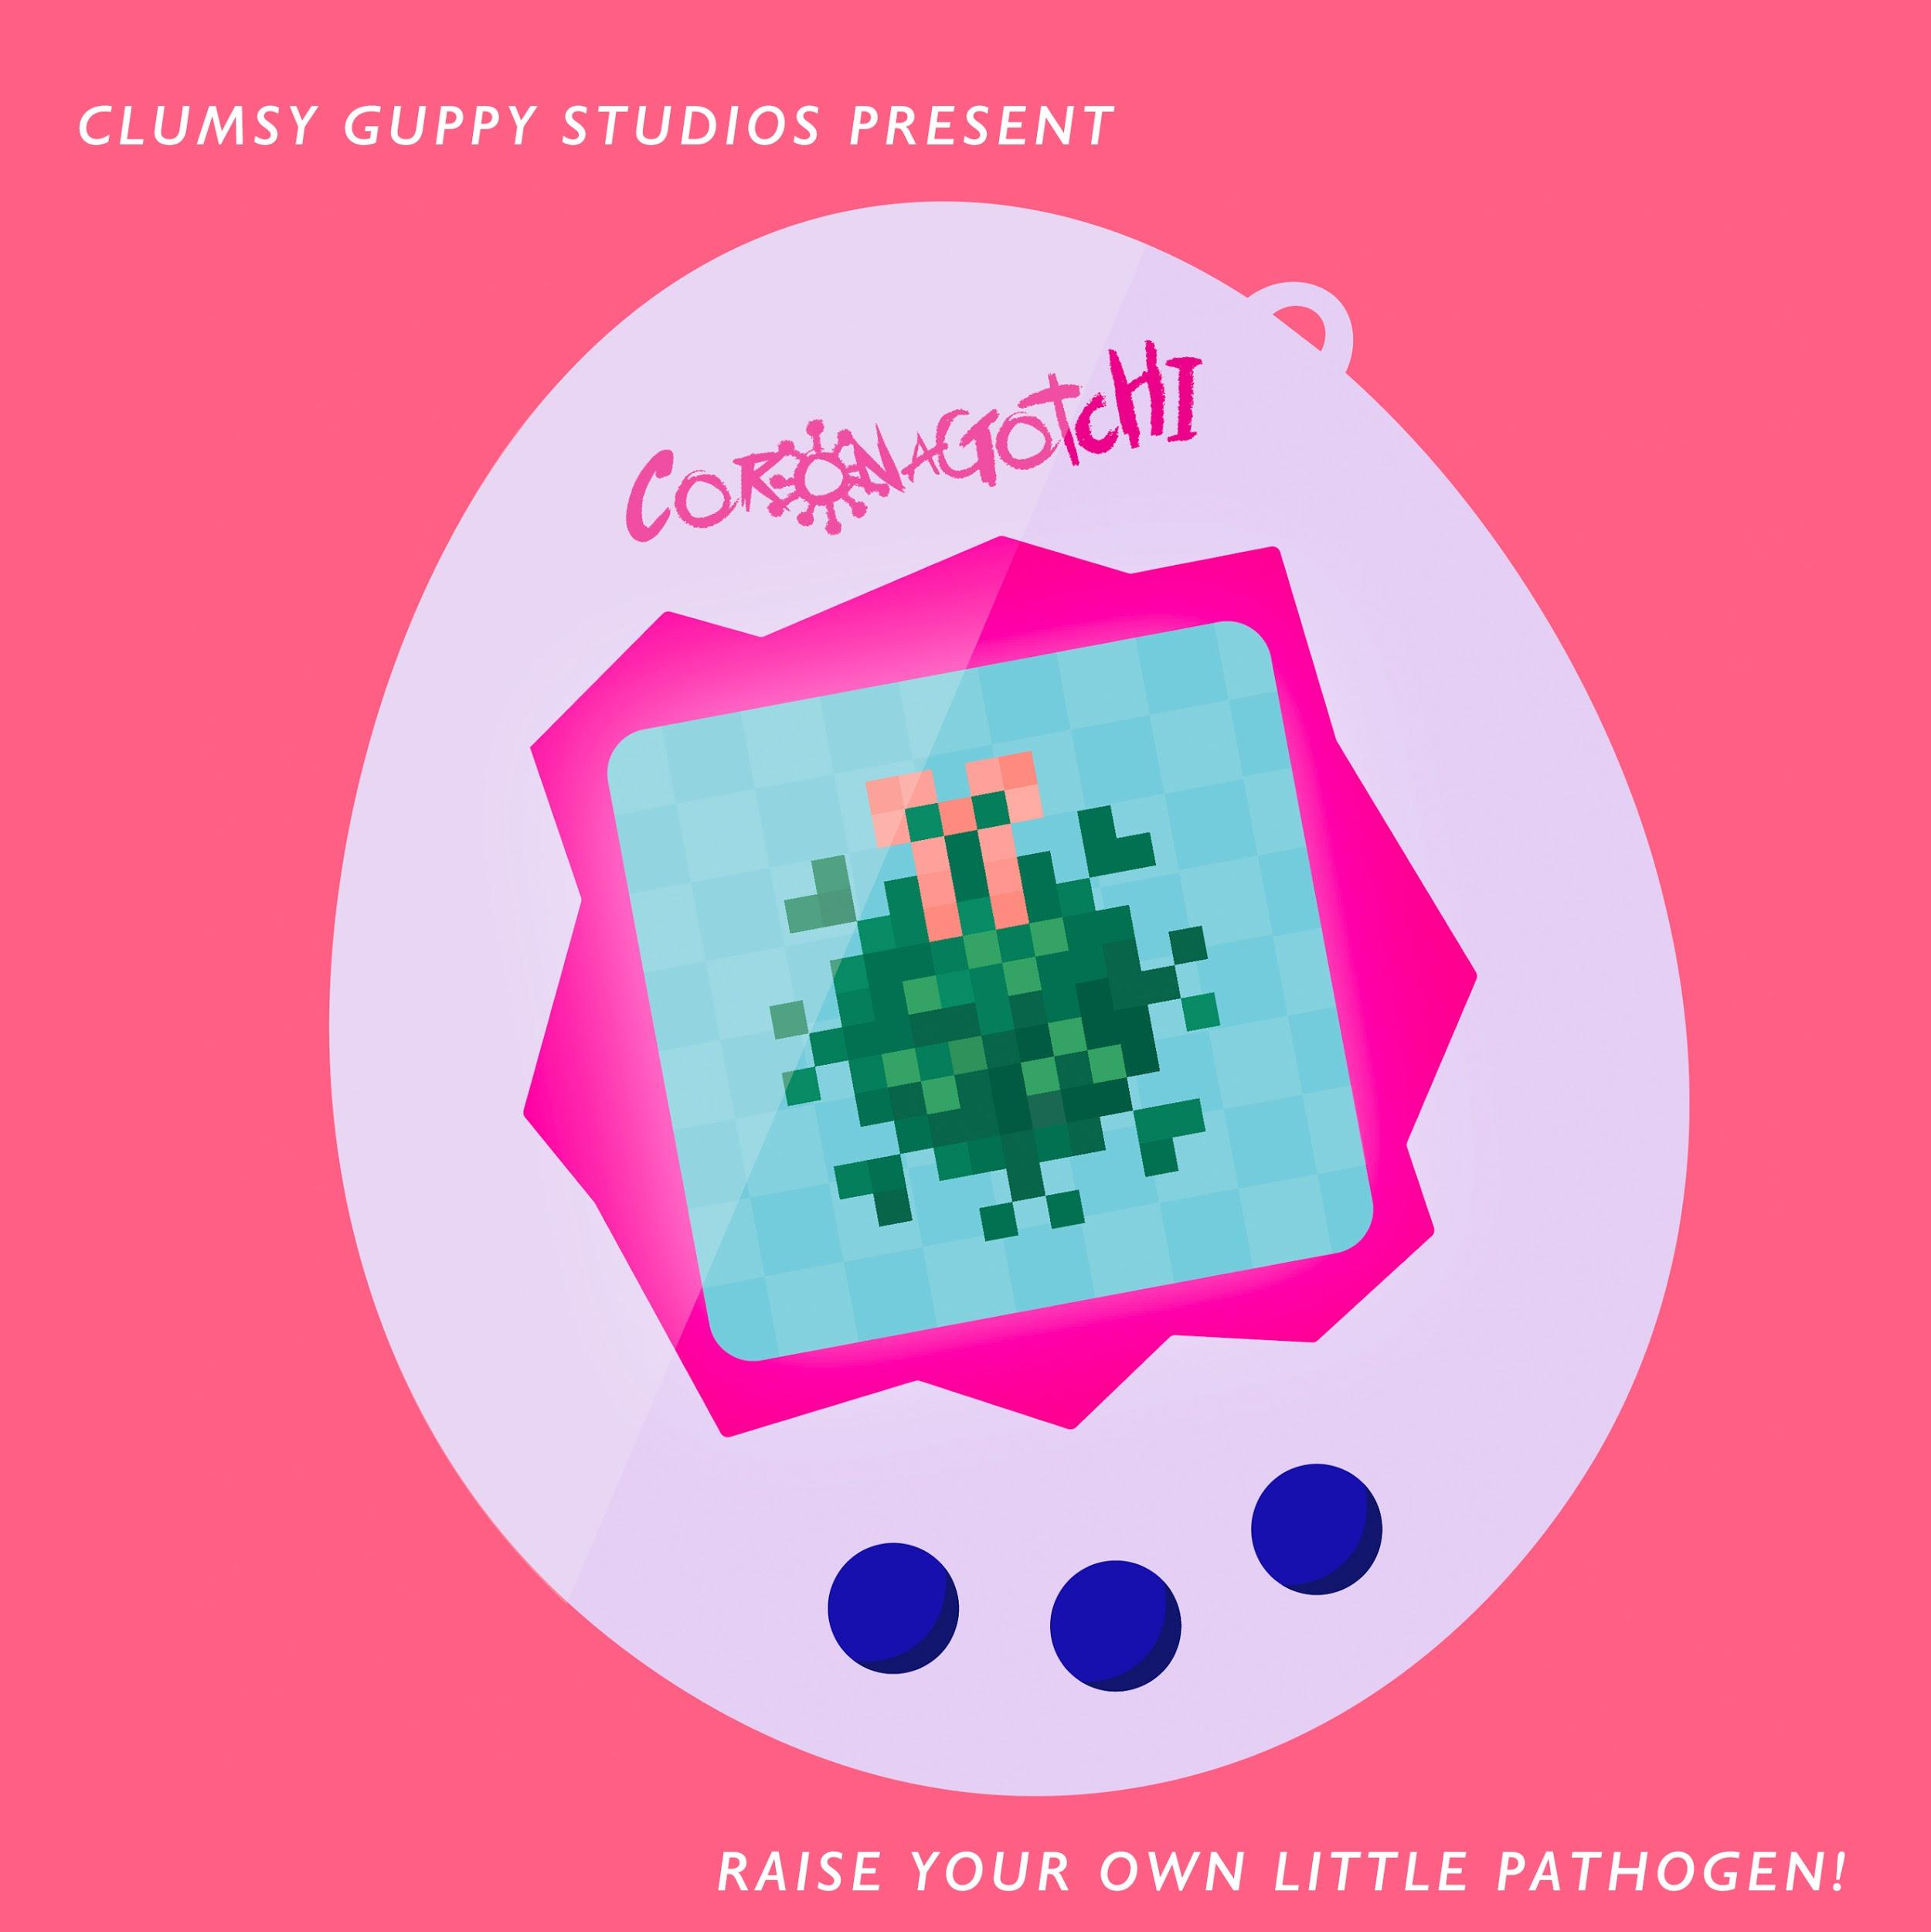
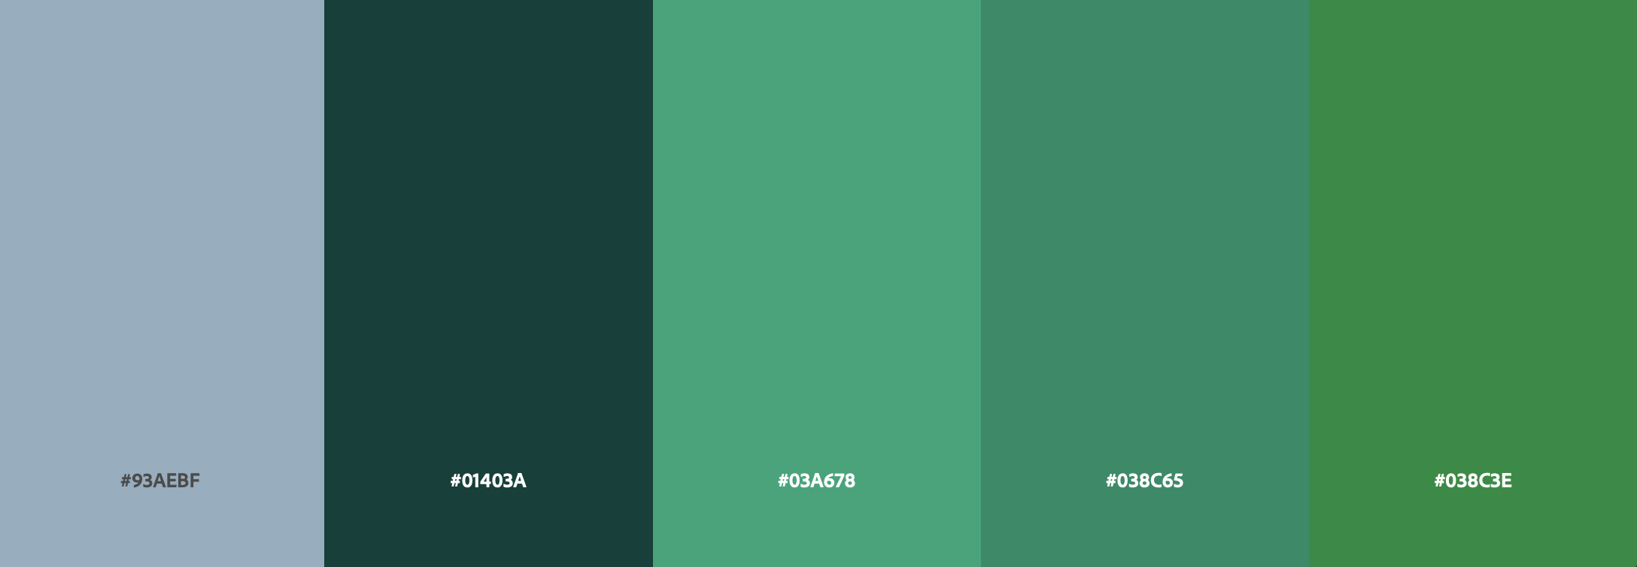
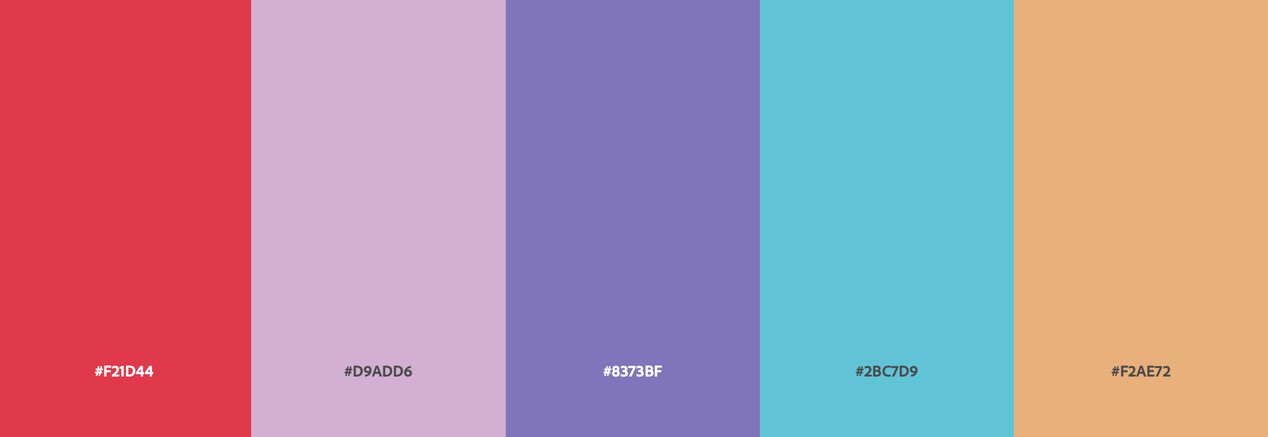
Cover Image
Color Scheme

Slide 8
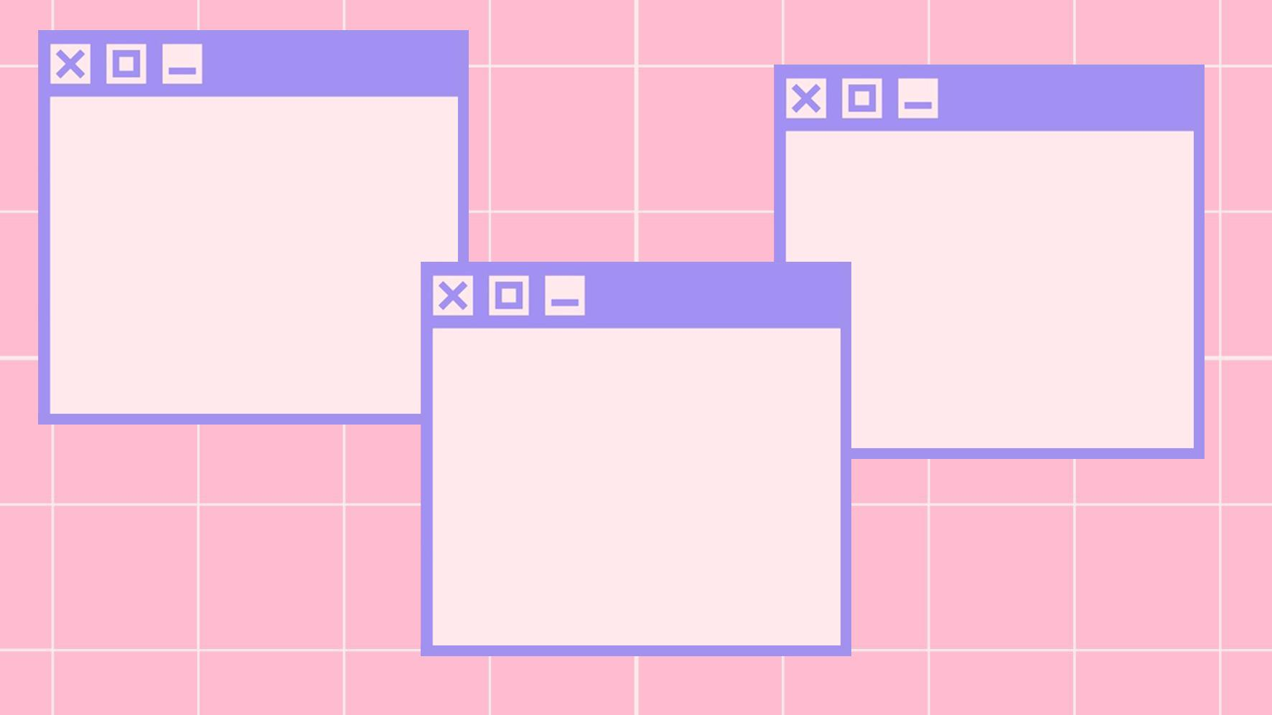
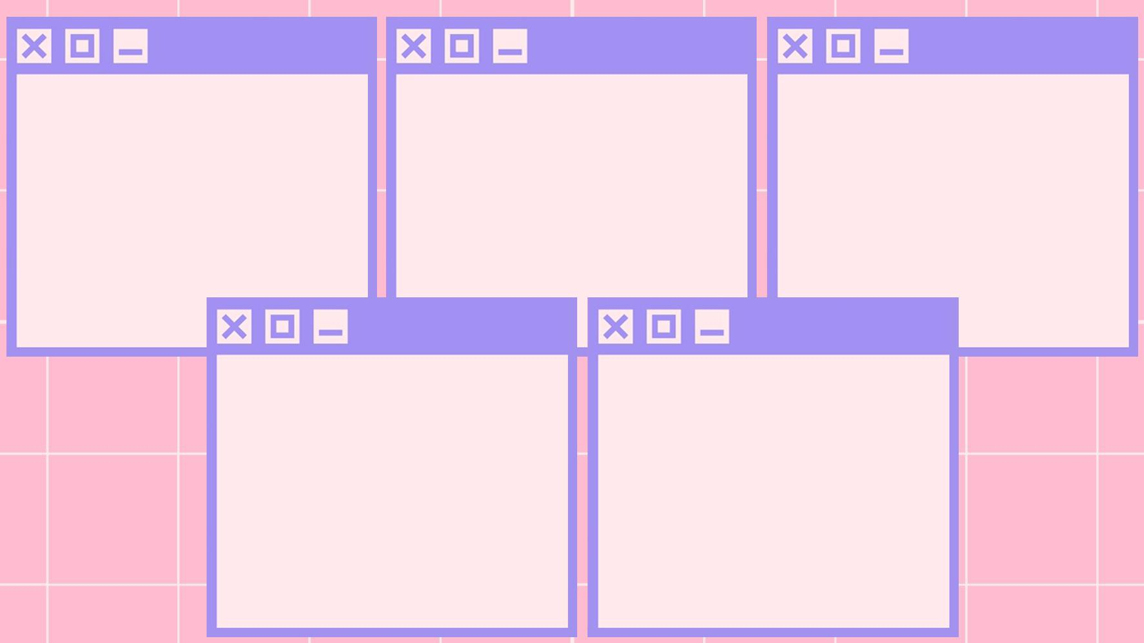
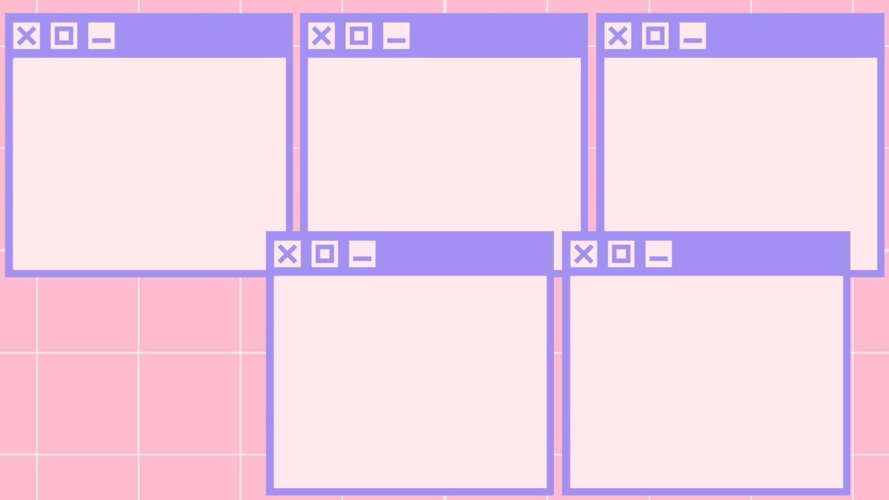


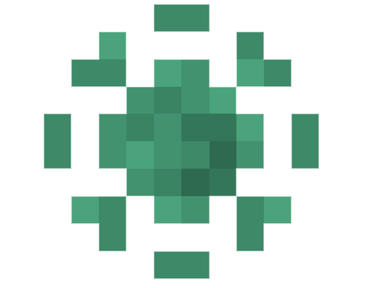

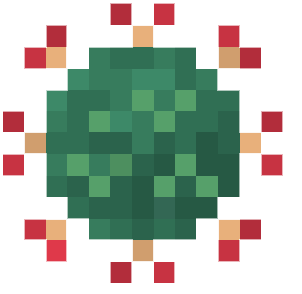
Corona-1
Corona-2
Corona-3
Corona-1
Corona-3
Corona-2
Corona-4
Corona-5
Corona age
progression
Corona age
progression
Corona age
progression

Slide 9
Corona Age Breakdown
If its stats are not depleted, Corona will age while the player is playing Coronagotchi.
Stage 1: until the player feeds Corona
Stage 2: 30 seconds
Stage 3: 30 seconds
Stage 4: 90 seconds
Stage 5: surprise ending!

Slide 10

Corona’s Stats
AGE
HAPPINESS
HUNGER

Slide 11
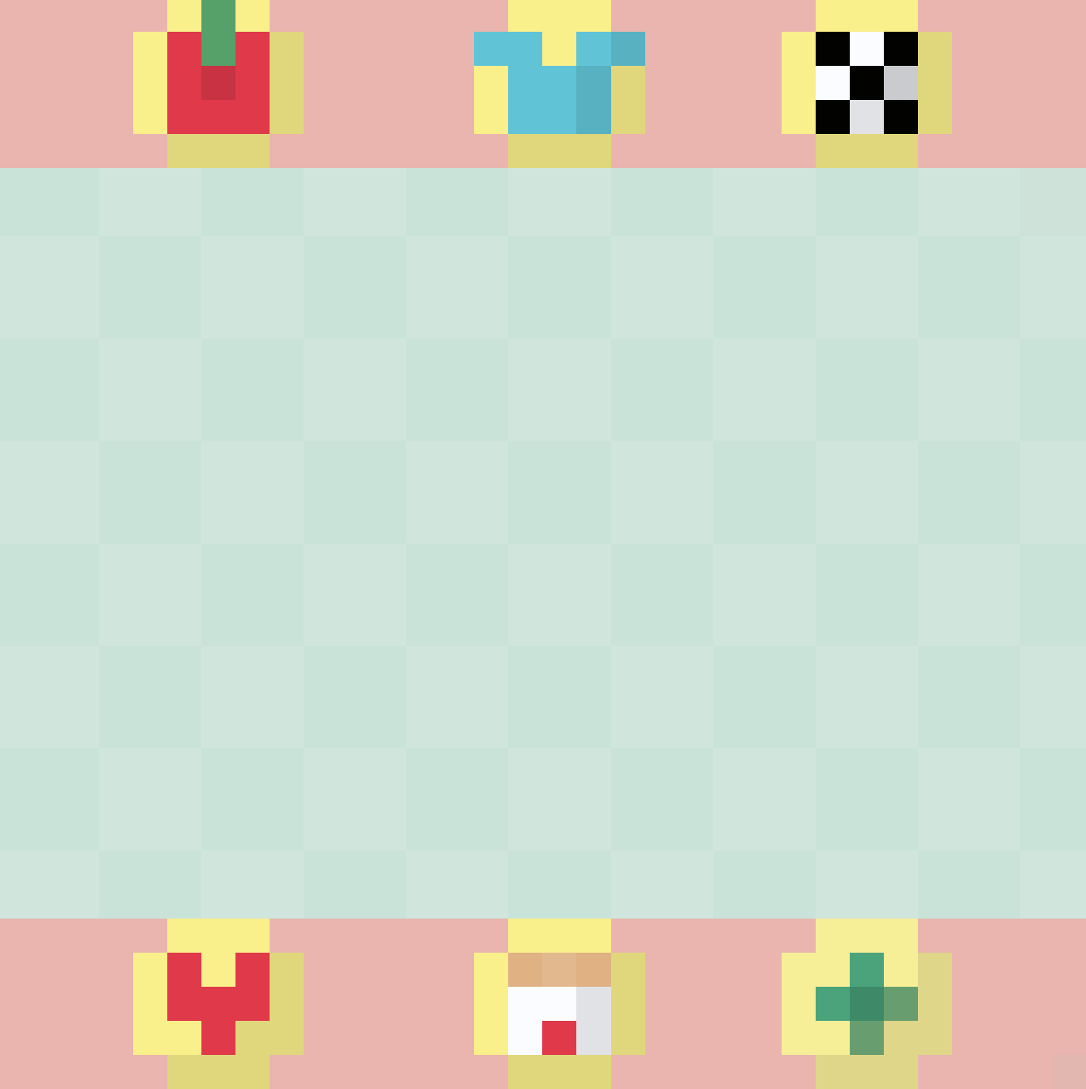
Home Screen
Mutation Minigame
Feeding game
Dress Up
(unlockable at stage 4)
Home
Block Breaker Minigame
Stats

Slide 12
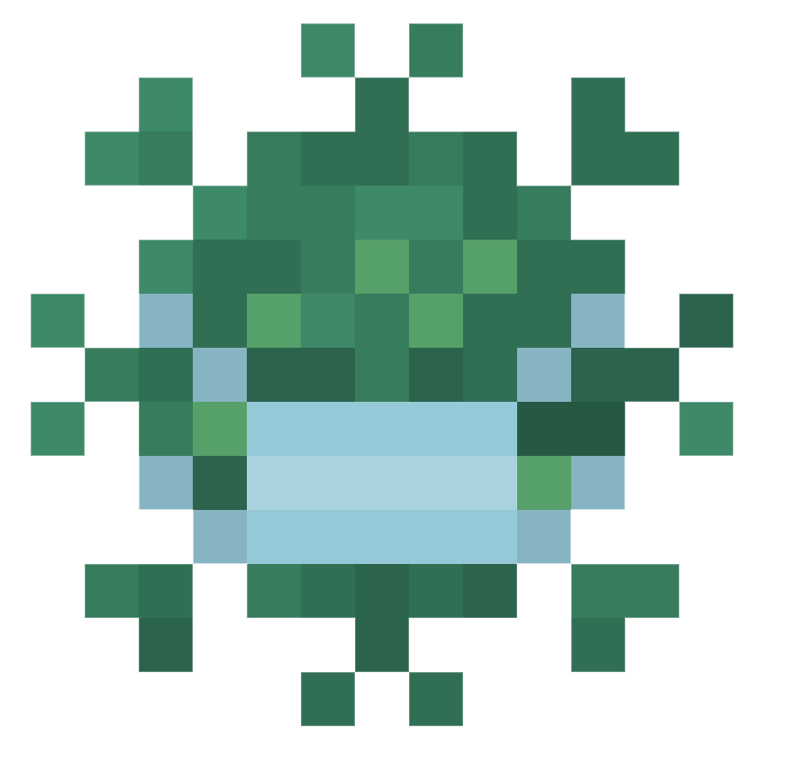
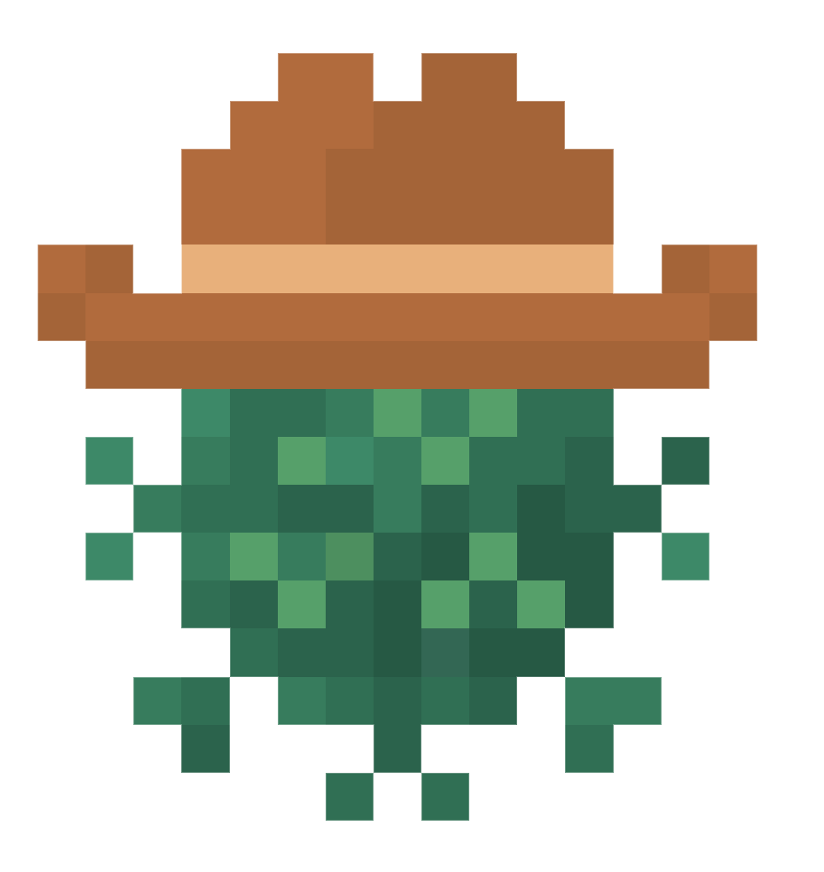

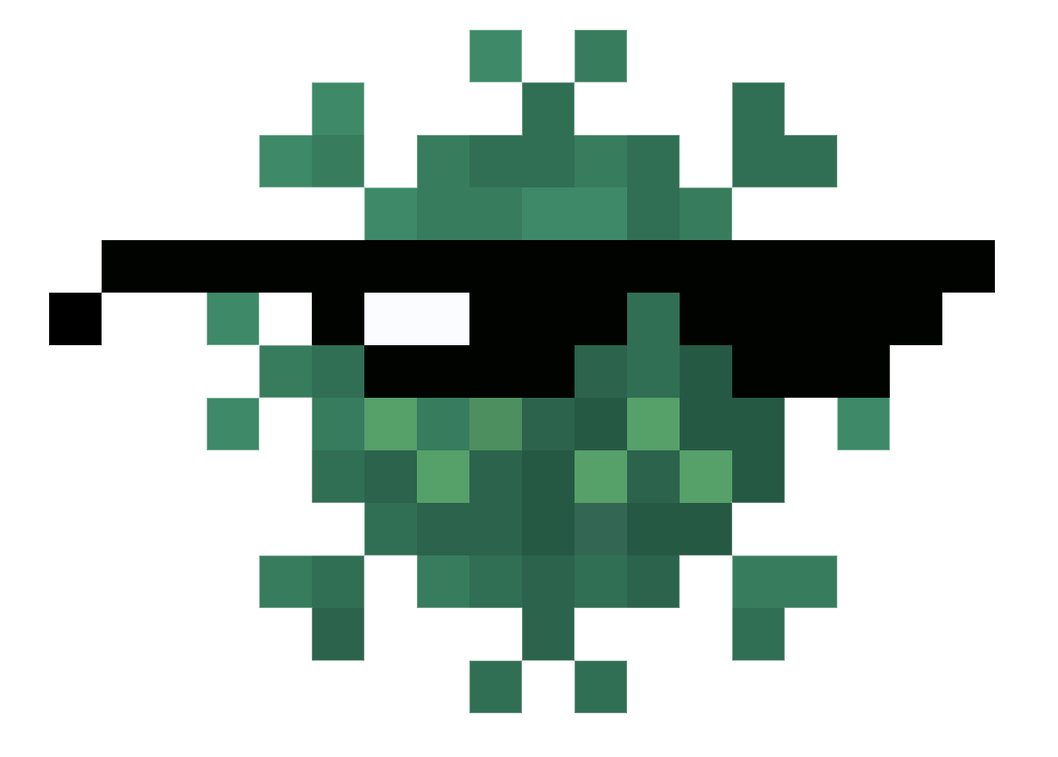
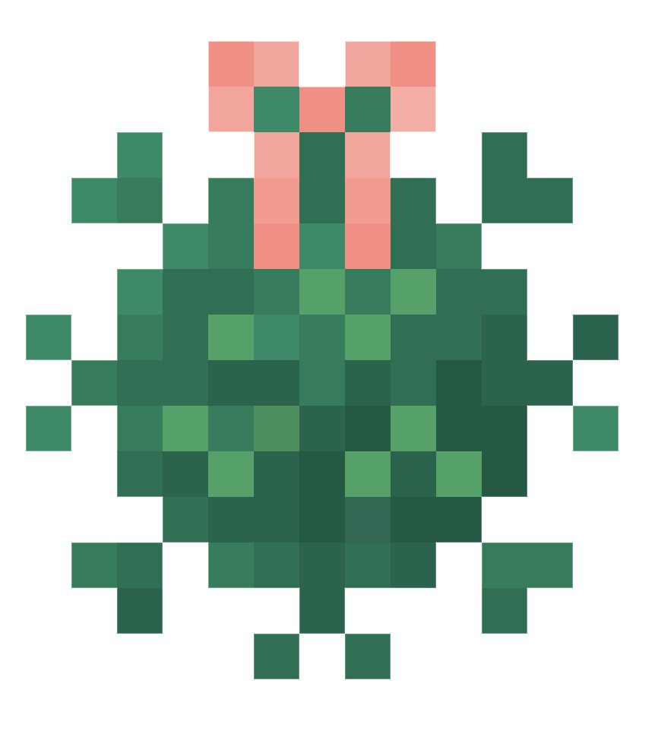
Pride
Mask
Cowboy
Corona-1
Corona-3
Corona-2
Shades
Bow
Dress up your Corona!
Corona age
progression
Corona age
progression

Slide 13


Death
If its happiness or hunger bars are depleted, Corona will die.

Slide 14
Playtesting
During Round 1 Playtesting:
Focused primarily on feedback about UI and ability to understand what the game was about
Added clarity to mini-games and UI elements by updating status text often and including on-hover labels for statistics
During Round 2 Playtesting:
Focused primarily on feedback about mini-games gameplay (feeding, dressing, memorizing DNA sequences)
Reduced difficulty of DNA memorization game by decreasing time between sequence being shown and being able to guess it
Added sound effects to sequence display to make it clearer when a new tile was being shown
In both sessions: always prioritized getting feedback on bugs and how to replicate them

Slide 15
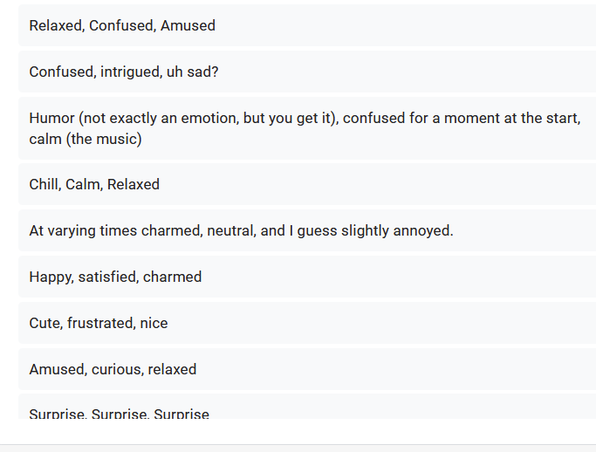
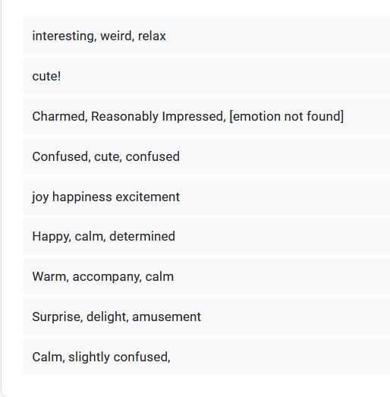
Surveys
What were 3 emotions you felt while playing?
Playtest Round 1
Playtest Round 2
Between rounds, saw reduction in number of responses with negative/neutral emotions such as confusion, annoyance, frustration, etc.

Slide 16
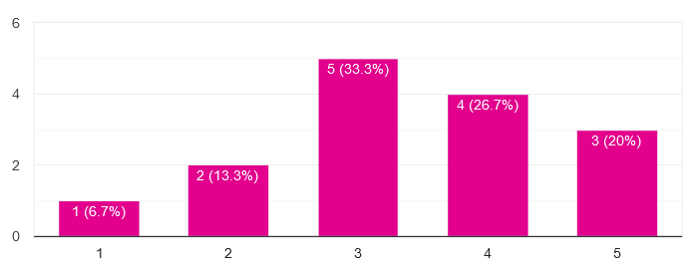
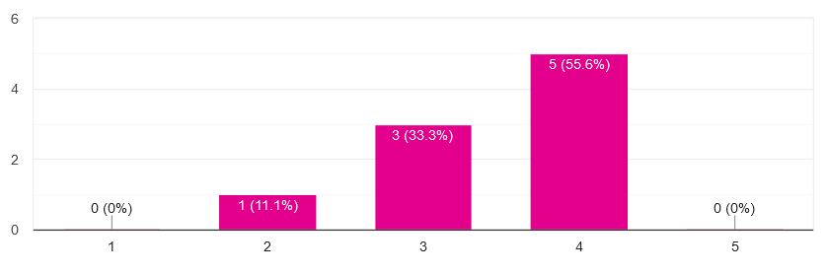
Surveys
Please briefly describe the primary theme/topic of game
Both round: most responses had to do with taking care of coronavirus like a Tamagotchi and/or pet simulators, which was exactly what we wanted.
How clear was the objective of the game?
Unclear
Very clear
Saw general increase in understanding between sessions due to additions of labels, notification system to warn of statistic changes, and clearer general UI.

Slide 17
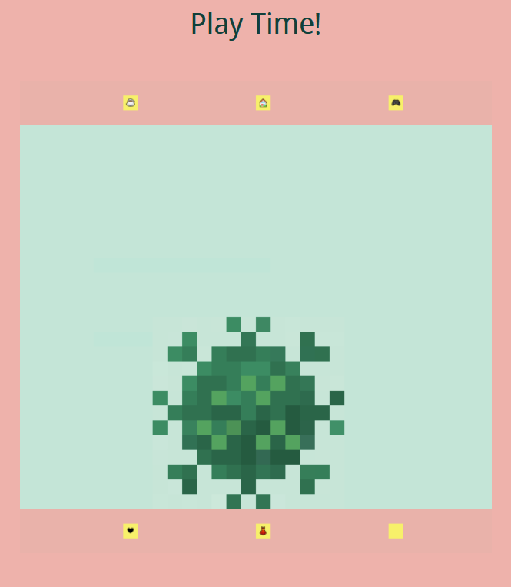
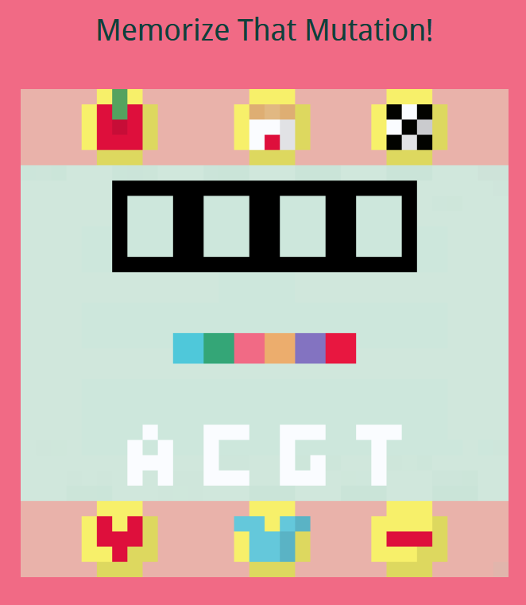
Surveys
Did buttons do what you expected them to do? How easy to navigate were the controls? How clear were the purposes of the different buttons?
Due to feedback that buttons were too small and difficult to understand in the first round of testing, we revamped the UI to include larger, clearer buttons, and status text labels for different games.
Round 1: Small buttons, unclear labels
Round 2: Large buttons with pictures, theme-appropriate labels

Slide 18



Surveys
Round 2 Survey included additional questions pertaining to the DNA memorization game, included notification system, and sound effects:
How did you feel about the notification system? If it was unclear, how would you suggest improving it?
Initial notification just showed a red/green dot on statistics button if a negative/positive change in stats occurred
Changed notification to flash between dark and light red/green to further clarify notification based on user suggestion.

Slide 19
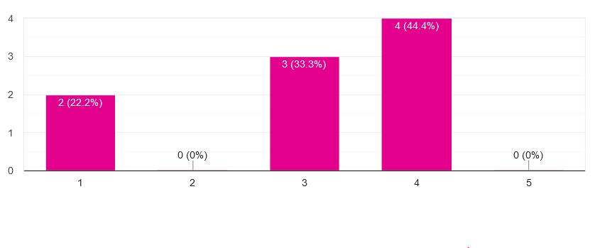
Surveys
How did you feel about the memorization game difficulty?
Very hard
Very easy
In general, responses were split between finding the game too difficult or just fine. In the “optional feedback” question most responses spoke of it being particularly hard to memorize the DNA sequence with so much time between being shown the sequence and being able to guess it.
Due to feedback, we decreased the amount of time between being shown the sequence to memorize and being able to guess it.

Slide 20
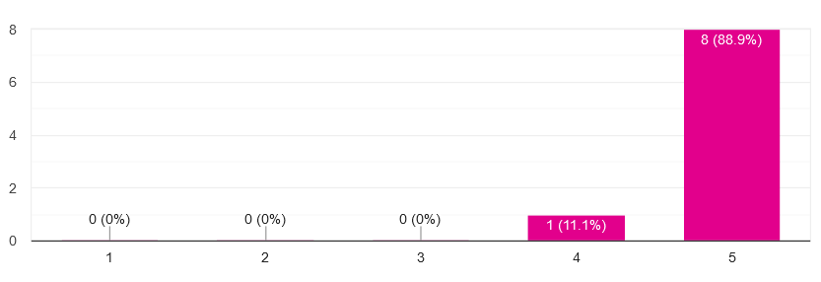
Surveys
How would you feel about introducing sound effects?
Hate it
Love it
In general, people were in favor of introducing sound effects. We therefore included sound effects for when Corona eats, when the DNA sequence flashes, when Corona bounces during the block breaker mini-game and just general Corona response/emotive noises.

Slide 21
Thanks.txt
Thank you for playing!
Notes:
Coronagotchi allows players to live out the nostalgia of older handheld games while either helping or harming their little Corona pet in this dark humor twist on the classic Tamagotchi.

